Slide 1

The Birds & the Bees
Puberty
Sarah Curtiss
And
Colleen Gibbons

Slide 2

Today’s Schedule
Schedule for the Day
Review Rights and Responsibilities
Definition of Puberty
“They Tell Me I’m Going Through Puberty”
Boys/Girls/Both
Puberty Worksheet
Diversity
Break Out Sessions
Closure

Slide 3
Rights and Responsibilities
To be heard.
To ask any questions.
To not be put down.
To pass.
To not have assumptions made about you.
To have your own feelings.
To say hello and good-bye to group members.
To be present.
To confidentiality.
Notes:
Rights

Slide 4
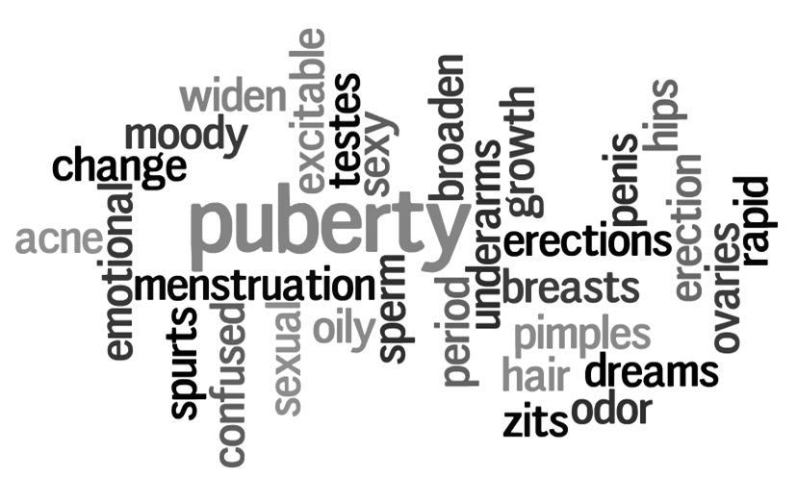
What is Puberty?
Notes:
Rights

Slide 5
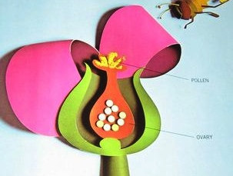
Puberty is your body changing from a child’s body to an adult’s body.

Slide 6
It causes changes to your body inside and outside.

Slide 7
Everyone goes through puberty but it might happen at different times and people’s bodies change to look different.

Slide 8
Puberty is a time when you start to get sexual feelings.

Slide 9
You don’t have control over going through puberty, but you do have control over how you react to it.

Slide 10
It’s normal to have mixed feelings, some good feelings and some negative feelings.

Slide 11
They Tell Me I’m Going Through Puberty
As we read the story…
Underline all the changes you notice
Answer the questions at the end.

Slide 12
Boys/Girls/Both
You have a cards with several changes that happen during puberty.
Decide if each change happens to boys, girls, or both.
If you don’t know what it means, ask Sarah or Colleen.

Slide 13
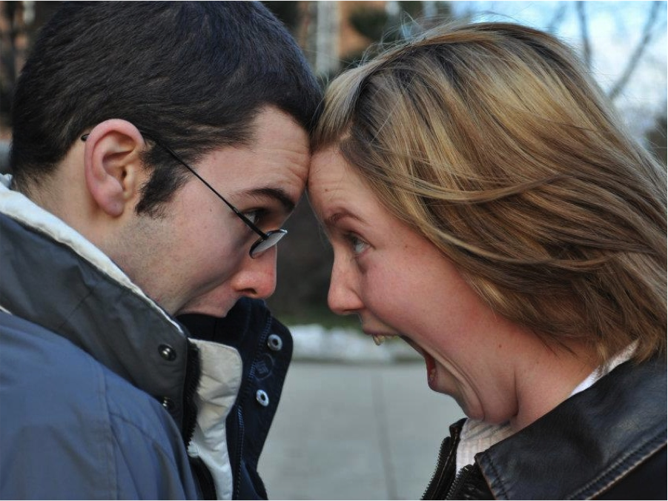
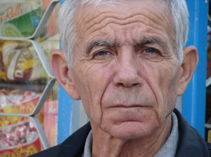
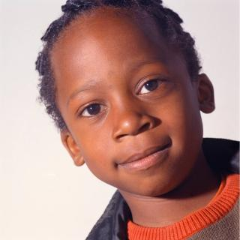

Which people are going through puberty?

Slide 14
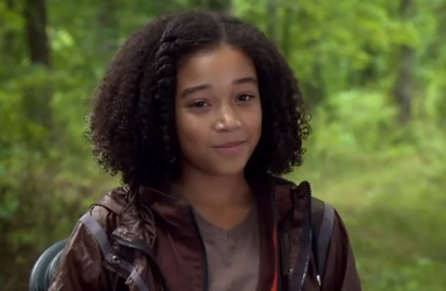
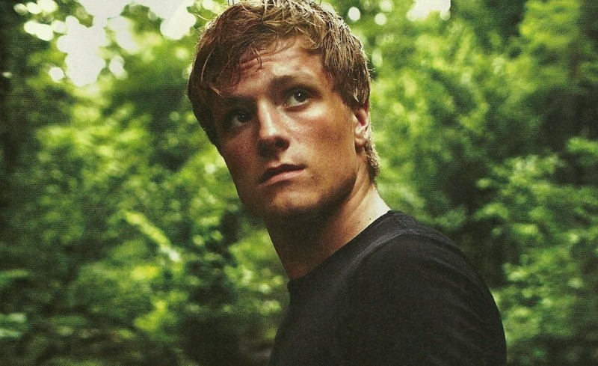
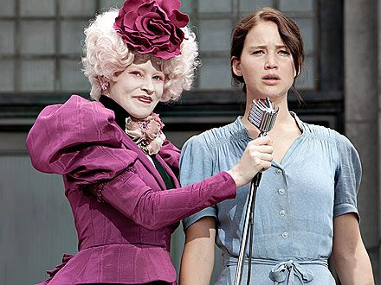
Which people are going through puberty?

Slide 15
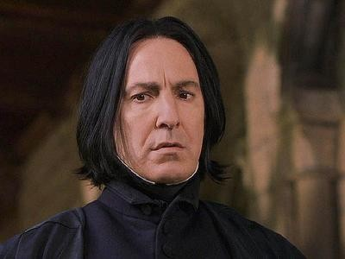
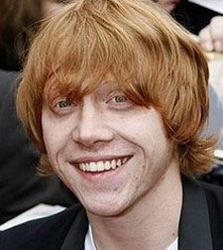


Which people are going through puberty?

Slide 16
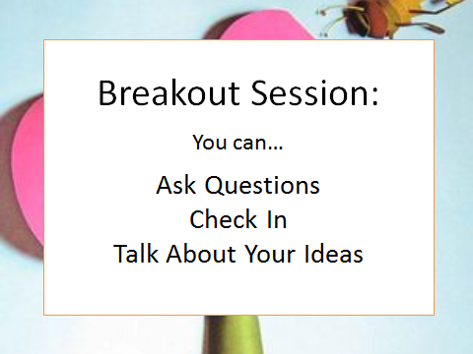

Slide 17
Closure
Great Job!
Next Week…Reproduction
Do you know what puberty is?
What changes happen during puberty?
Don’t forget to say good-bye!
Go over schedule
Reproduction Video
Breakout Session
Closure

