Slide 1

Human Sexuality 101
Welcome Week
with
Sarah Curtiss &
Chelsie Lonbom

Slide 2

Today’s Schedule
Go Over the Schedule
Rights and Responsibilities
Question Box
Move Your Boodie…
Make Name Cards
Defining Human Sexuality
Breakout Sessions
Closure

Slide 3
Rights and Responsibilities
To be heard.
To ask any questions.
To not be put down.
To pass.
To not have assumptions made about you.
To have your own feelings.
To say hello and good-bye to group members.
To be present.
To confidentiality.
Notes:
Rights

Slide 4
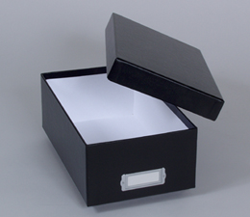
Question Box
A place to put any questions you don’t want to say out loud to the group.

Slide 5
Move Your Boodie
It’s kind of like musical chairs without the music.
Movie you boodie if…

Slide 6
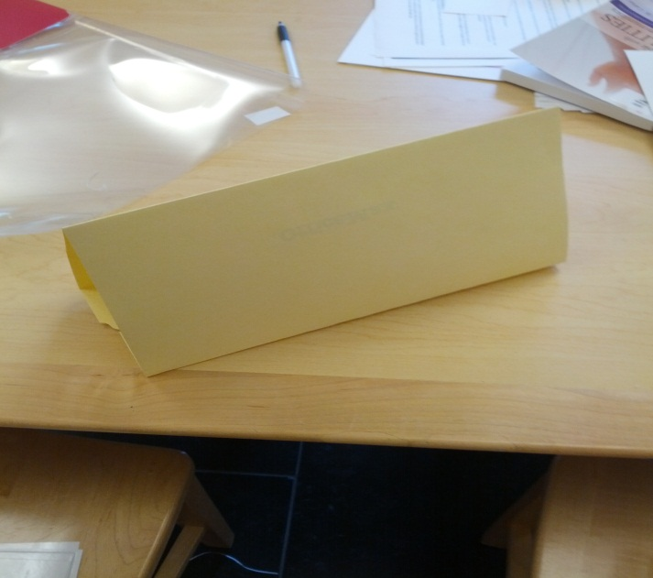

Name Cards
Outside/Public Part:
Describe yourself the way that everybody sees you.
Inside/Private Part:
Describe yourself the way only you see you.

Slide 7
Defining Human Sexuality
We’re Going to come up with a definition together. Start with filling out the worksheet.
Human sexuality is…

Slide 8
Breakout Session:
You can…
Ask Questions
Check In
Talk About Your Ideas

Slide 9

Closure
Great Job!
Next Week…Anatomy
This is a safe and comfortable space.
You’ve got to know people a little bit and people have gotten to know you.
Don’t forget to say good-bye!
Go over schedule
Body Parts and Post-it Notes
Terminology
Fruity Anatomical Models
Breakout Session
Closure

