Slide 1

Human Sexuality 101
Anatomy
with
Sarah Curtiss &
Chelsie Lonbom

Slide 2

Today’s Schedule
Parts and Post-it Notes
Terminology
Fruity Anatomical Models
Privacy
Breakout Sessions
Closure

Slide 3
Penis
Vagina
Vulva
Testes
Ovaries

Slide 4
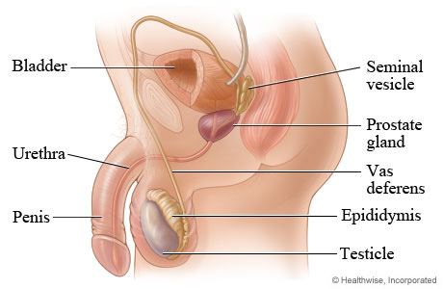
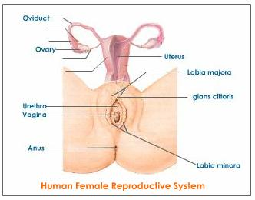
Fruity Anatomical Models
Male
Female
Notes:
Rights

Slide 5
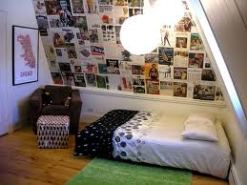
Privacy
Is something personal, something you keep to your self, something you don’t share or share with few people.

Slide 6
Breakout Session:
You can…
Ask Questions
Check In
Talk About Your Ideas

Slide 7

Closure
Great Job!
Next Week…Puberty
You learned about sexual body parts.
You thought about your emotions.
You learned about privacy.
Don’t forget to say good-bye!
Go over schedule
Boys, Girls, Both
Changes
Diversity
Video
Breakout Session
Closure

