Slide 1

The Birds & the Bees
Crushes
Sarah Curtiss
And
Colleen Gibbons

Slide 2

Today’s Schedule
Schedule for the Day
Review Rights and Responsibilities
What is a Crush?
How to Deal with a Crush
How to Turn Someone Down
Break Out Sessions
Closure

Slide 3
Rights and Responsibilities
To be heard.
To ask any questions.
To not be put down.
To pass.
To not have assumptions made about you.
To have your own feelings.
To say hello and good-bye to group members.
To be present.
To confidentiality.
Notes:
Rights

Slide 4
What if someone likes you but you don’t like them back?
Say No with a reason
  You’re really nice, but I just don’t like you that way.
Say No with an alternative
  I don’t want to go out with you, but we can be friends.
Say No and go
  I won’t go out with you.

Slide 5
Let’s Practice
Choose a partner, one person be the person with the crush and the other will practice turning someone down. For example,
“I really like you, I think we should hang out sometime. Can I call you?”
“I don’t think that’s a good idea. I don’t really like you that way.”

Slide 6
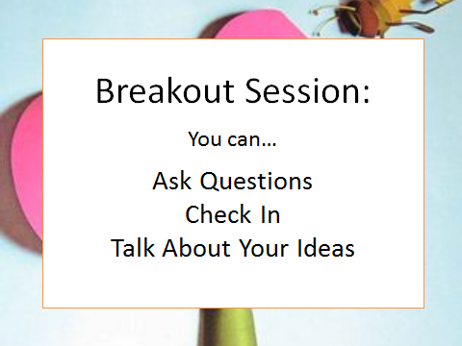

Slide 7

Closure
Food for thought
Next Week…Body Image
Do you know what a crush is?
What would you do if you had a crush?
What would you do if someone had a crush on you but you didn’t like them back?
Don’t forget to say good-bye!
Go over schedule
How I feel about me
Body Image and the media
Positive self talk
Breakout Session
Closure

