Slide 1

The Birds & the Bees
Crushes
Sarah Curtiss
Chelsie Lonbom
Colleen Gibbons

Slide 2

Today’s Schedule
Schedule for the Day
Review Rights and Responsibilities
How I Feel About my Body
Positive Self-Talk
Role-Play
Self-Portraits
Break out Sessions
Closure

Slide 3
Rights and Responsibilities
No Talking When Someone Else is Talking
No Hitting
No Name Calling
Notes:
Rights

Slide 4
What is Body Image?
How we think and feel about our body and appearance.

Slide 5
How I Feel About My Body
Each person will write down how they feel about their body. DON’T PUT YOUR NAME ON IT.
We will collect all the answers.
Each person will get someone’s answer- if you get your own, just pretend you don’t know who wrote it.
Each person will read the answer.
Don’t try to guess who wrote what or share which one is yours.

Slide 6
Positive Self-Talk
“I love my body just the way it is”
“I might not be perfect in their eyes, but nobody is! I like my body.”
“There isn’t one ‘perfect’ body type. I feel good about how I look.”
“My body allows me to do my favorite things, like _____________” (ex. Run, swim, dance, be with friends,…)
“I love my _______________________ because it allows me to _________________.”
“I am unique and original and am thankful for my body.”

Slide 7
Small Group Role Play
Girls
Boys
You are shopping with your friends and have to buy a bigger size than the other girls
Someone comments on how skinny your sister is in front of you
You are picked last for a team in gym class because the captain said you aren’t very athletic
You are walking down the hall and an older boy calls you “shorty”
You are in gym class and cannot climb the rope. Some boys make fun of your “small muscles”
You are picked last for a team in gym class because the captain said you aren’t very athletic

Slide 8
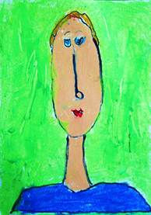
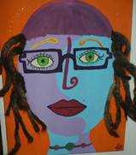
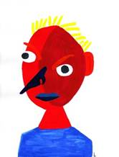
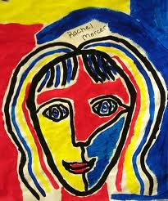
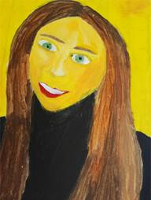
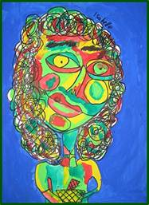
Self Portraits

Slide 9
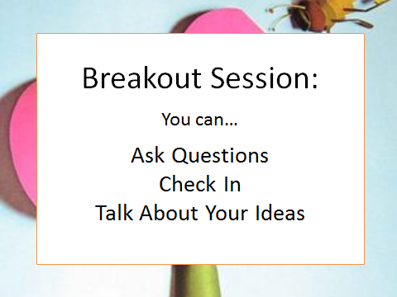

Slide 10

Closure
Food for thought
Next Week…Hygiene
How do you feel about your body?
What can you do if you feel bad about your body?
Don’t forget to say good-bye!
Go over schedule
Hygiene Olympics
Breakout Session
Closure

