Slide 1

The Birds & the Bees
Body Image
Sarah Curtiss
Andrea Harrell

Slide 2

Today’s Schedule
How I Feel About my Body
Positive Self-Talk
Role-Play
Self-Portraits

Slide 3
What is Body Image?
How we think and feel about our body and appearance.

Slide 4
Body Stories
Circle all the feeling words in the story.
Underline when the author talks about his or her feelings changing.
Underline when the author talks about misconceptions people have because of his or her body.

Slide 5
45% of healthy weight women and 23% of healthy weight men
describe themselves as overweight

Slide 6
50% of 3rd-6th graders indicate that they want to be thinner

Slide 7
The average woman’s height is 5’4” and she weighs 144 pounds …
The average model is 5’ 11” and weighs 117 pounds.

Slide 8
Some people feel so bad about their bodies, they develop eating disorders. Eating disorders are dangerous and can lead to death.

Slide 9
4 out of 5 children at age 10 are afraid of being fat

Slide 10

What Influences People to Feel the Way they do?

Slide 11
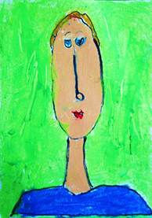
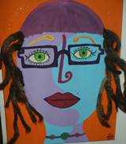
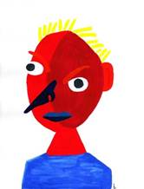
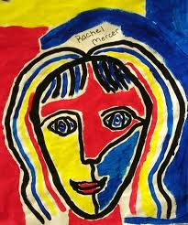
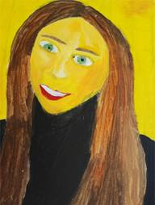
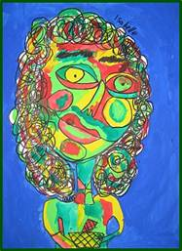
Self Portraits

Slide 12

What did you learn today?
Next Week…Crushes
  What is a crush
  How to deal with a crush
  Asking someone out
  Turning someone down

