Slide 1

The Birds & the Bees
Intimacy
Andrea Harrell

Slide 2

Today’s Schedule
Schedule for the Day
What is a intimacy?
Picture activity
5 Point Scale: Intimacy
“How to Achieve Intimacy” video
Closure

Slide 3
What is intimacy?
close familiarity or friendship
a close, familiar, and usually affectionate or loving personal relationship with another person or group
emotional and/or physical closeness

Slide 4

What is intimacy?

Slide 5
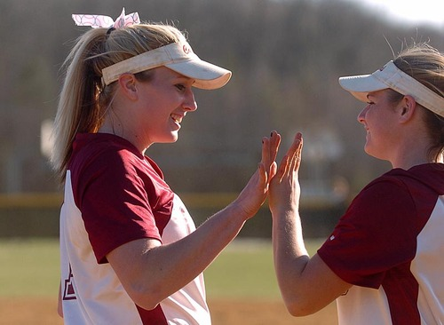
What is intimacy?

Slide 6
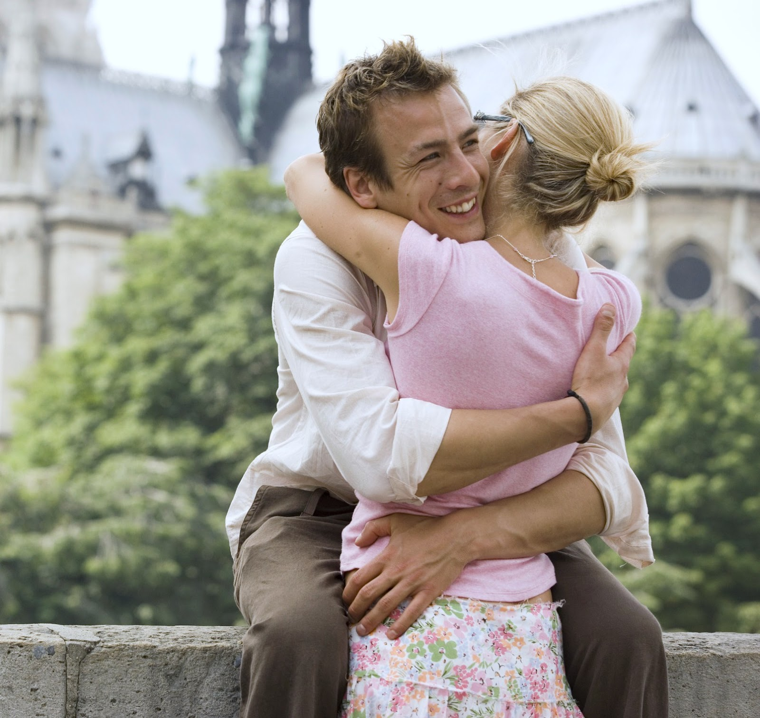
What is intimacy?

Slide 7
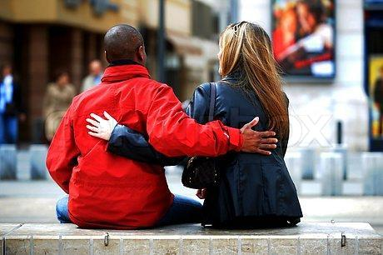
What is intimacy?

Slide 8
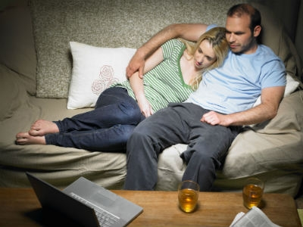
What is intimacy?

Slide 9

What is intimacy?

Slide 10
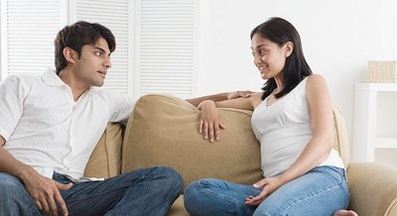
What is intimacy?

Slide 11
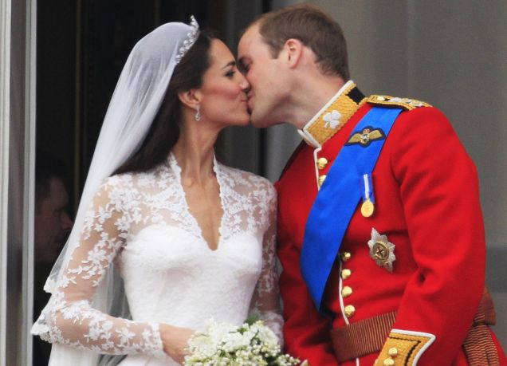
What is intimacy?

Slide 12
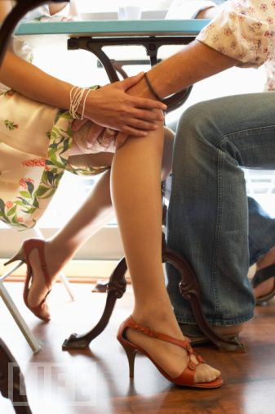
What is intimacy?

Slide 13
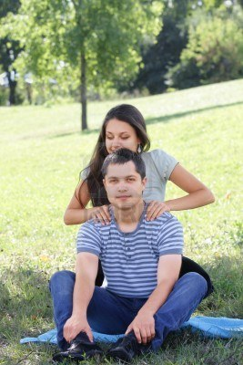
What is intimacy?

Slide 14
Intimacy
http://www.youtube.com/watch?v=wmB12P6V-X0&feature=plcp

