Slide 1

The Birds & the Bees
Crushes
Sarah Curtiss
And
Colleen Gibbons

Slide 2

Today’s Schedule
Schedule for the Day
What is a Crush?
How to Deal with a Crush
How to Turn Someone Down
Break Out Sessions
Closure

Slide 3
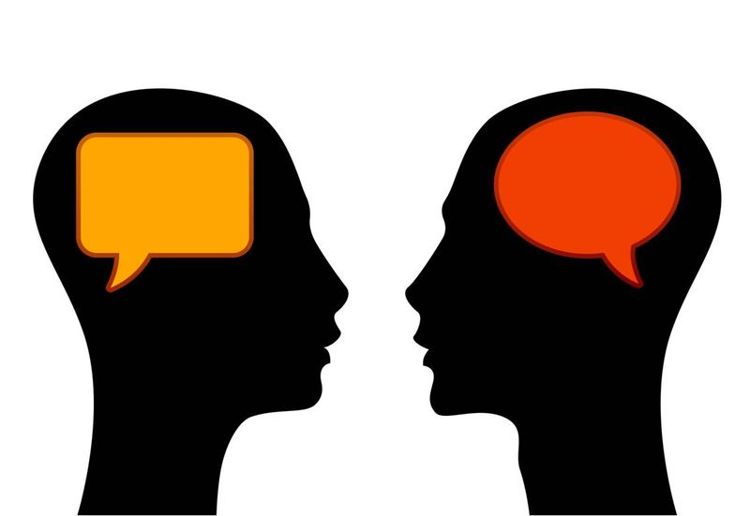
What is a Crush?

Slide 4
How to Handle a Crush
What if you like a friend http://www.youtube.com/watch?v=r0kRS4-IK38
How to tell if a guy likes you http://www.youtube.com/watch?v=fdrum5TArW0&feature=relmfu
How to get a guy’s attention http://www.youtube.com/watch?v=2E5oWucpeSU&feature=relmfu

Slide 5
What if someone likes you but you don’t like them back?
Say No with a reason
  You’re really nice, but I just don’t like you that way.
Say No with an alternative
  I don’t want to go out with you, but we can be friends.
Say No and go
  I won’t go out with you.

Slide 6
Let’s Practice
“I really like you, I think we should hang out sometime. Can I call you?”
“I don’t think that’s a good idea. I don’t really like you that way.”

Slide 7
How to know when to say “no”
http://www.thatsnotcool.com/TwoSidedStories.aspx?Title=THE%20BREAK-IN

