Slide 1

Human Sexuality 101
Anatomy
with
Sarah Curtiss &
Andrea Harrell

Slide 2

Today’s Schedule
Parts and Post-it Notes
Terminology
Fruity Anatomical Models
Miracle of Life
What did I learn?

Slide 3
Penis
Vagina
Vulva
Testes
Ovaries

Slide 4
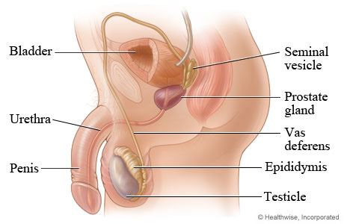
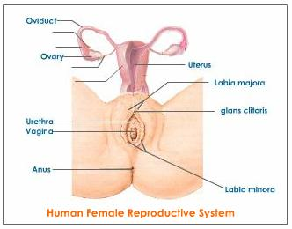
Fruity Anatomical Models
Male
Female
Notes:
Rights

Slide 5
Miracle of Life
http://video.pbs.org/video/1841157252/

Slide 6
What did you learn?
Next Week: Body Image

